Slide 1
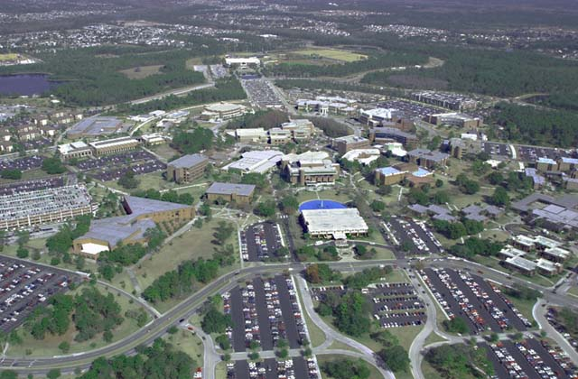
Static program analysis of Scala based on JastAdd
Bingbing Rao
M.S. Computer Science
2016-04-21
1

Slide 2
Outline
Introduction
Motivation
Work finished
Scala Programming Language
The Features of Scala (vs Java)
Scala Syntax (basically)
Type Checking (basically)
Data Flow Analysis
Available expressions Analysis
Reaching definition Analysis
Very Busy Expressions Analysis
Live Variables Analysis
Summary
References
Questions
2

Slide 3
Motivation
It is difficult to debug applications of distributed system (Spark and Hadoop– log analysis tools)
Scala Compiler and other analysis tools (Findbugs –bytecodes level) do program analysis work based on program (run properly and find deadlocks)
Is there any tools that can do some analysis based on applications?
Limitation about Application
Reduceing the number of Map/Reduce operations (Spark)
How to write a efficient program apply for application?
Performance issue (memory issue)
Straggler problem (cpu, memory, network..)
Based on AST, get info from running time (advanced topic,ASM tools)
Objective:
Implement static program analysis of Scala based on JastAdd tool
Understand concepts about static program analysis deeply(AST)
3
Notes:
Diff kinds of Scenarios will be used as Ref module

Slide 4
Work finished (based on JastAdd)
Implement tools: JastAdd/Java/ant/eclipse
Finished work:
Lexical (Scanner, Jflex) and Syntax (Parser, Beaver) Analysis
Generate abstract syntax tree
Type checking
Data Flow Analysis
Available expressions analysis
Reaching Definition Analysis
Very Busy Expressions Analysis
Live Variables Analysis
4

Slide 5
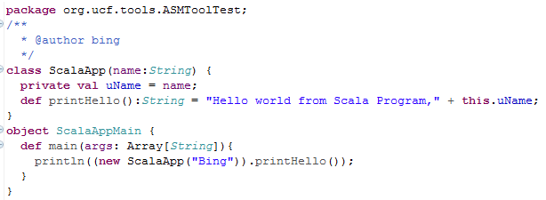
The Features of Scala (vs Java)
Scala is object-oriented (All types are objects，int)
Scala is functional (flexibility but difficult to read)
Scala is statically typed (type inference, java)
Scala runs on the JVM (Bytecode)
Scala can Execute Java Code, and vice versa (Bytecode)
5
Notes:
the Java programming language supports seven other primitive data types. A primitive type is predefined by the language and is named by a reserved keyword.
A language is statically typed if the type of a variable is known at compile time. This in practice means that you as the programmer must specify what type each variable is. Example: Java, C, C++
The main advantage here is that all kinds of checking can be done by the compiler, and therefore a lot of stupid bugs are caught at a very early stage.
A language is dynamically typed if the type of a variable is interpreted at runtime. This means that you as a programmer can write a little quicker because you do not have to specify type everytime. Example: Perl, Ruby, Python
Most scripting languages have this feature as there is no compiler to do static typechecking anyway, but you may find yourself searching for a bug that is due to the interpreter misinterpreting the type of a variable. Luckily, scripts tend to be small so bugs have not so many places to hide.
Most dynamically typed languages do allow you to provide type information, but do not require it. One language that is currently being developed (Rascal) takes a hybrid approach allowing dynamic typing within functions but enforcing static typing for the function signature.

Slide 6



Scala Syntax(basically)
Syntax Summary
a ::= x| n | a1 opa a2
b ::= true| false | not b| b1 opb b2 | a1 opr a2
S ::= x = a | y += 6 -----------------Assignment
| var x:Int -----------------Declare a variable x
| val y:Int = 5 -----------------Define a variable y
| if (b) {S1} else {S2} -----------------if else statement
| while(b) {S} -----------------While statement
| S1;S2 -----------------sequential statements
6
Notes:
http://www.scala-lang.org/files/archive/spec/2.11/01-lexical-syntax.html
http://www.scala-lang.org/files/archive/spec/2.11/13-syntax-summary.html
http://www.scala-lang.org/files/archive/spec/2.11/

Slide 7
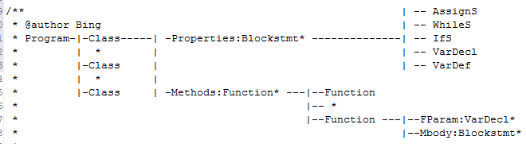
Structure of a Scala program
A program consist of classes
A class consist of Properties (Fields) and methods
Just focus on analysis about Properties. (Intraprocedural Analysis)
7

Slide 8
Type Checking (basically)
Source code
8

Slide 9
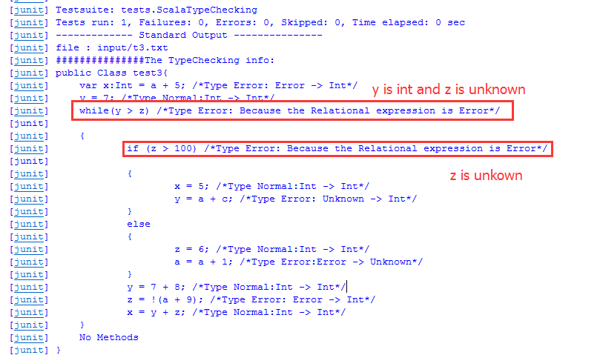
Junit Test Case of Type Check
9

Slide 10
Data Flow Analysis
Definition
Derive information about the dynamic behavior (the flow information) of a program
Based on all paths through program (CFG)
by only examining the static code
Applications
Applicability of code optimizations
Symbolic debugging of optimized code
Static error checking
Type inference
10

Slide 11
Classical Data Flow Analyses
Available Expression Analysis
Reaching Definition Analysis
Very Busy Expressions Analysis
Live Variables Analysis
11

Slide 12
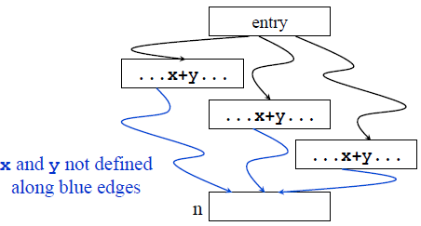
Available Expression Analysis
For each program point, which expressions must have already been computed, and not latter modified, on all paths to the program.
Example: x+y is available at program point n
12
Notes:
An expression, x+y, is available at node n if every path from the entry node to n evaluates x+y, and there are no definitions of x or y after the last evaluation
An expression (e.g., x+y) is available at node n if every path from the entry node to n evaluates x+y, and there are no definitions of x or y after the last evaluation along that path

Slide 13
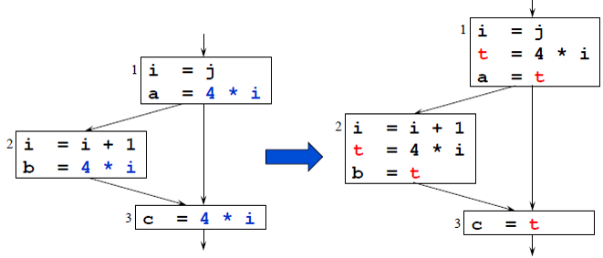
Uses of Available Expressions
Common subexpression elimination
If an expression is available at a point where it is evaluated, it need not be recomputed( still in a register somewhere)
Example: (4*i is available block 1, 2 and 3)
13
Notes:
https://en.wikipedia.org/wiki/Common_subexpression_elimination
In compiler theory, common subexpression elimination (CSE) is a compiler optimization that searches for instances of identical expressions (i.e., they all evaluate to the same value), and analyses whether it is worthwhile replacing them with a single variable holding the computed value.
1. Find common subexpressions whose range spans the same basic blocks and eliminate unnecessary re-evaluations
2. Leverage available expressions

Slide 14
Equations of Available Expressions
Source code
14

Slide 15
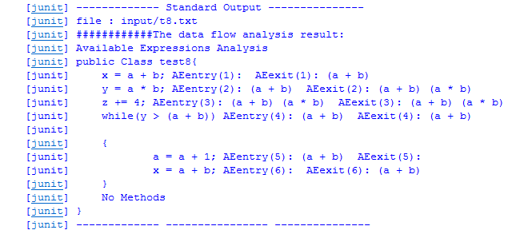
Junit Test Case of AE
15

Slide 16
Reaching Definition Analysis
For each program point, which assignments may have been made and not overwritten, when program execution reaches this point along some path.
example
16

Slide 17
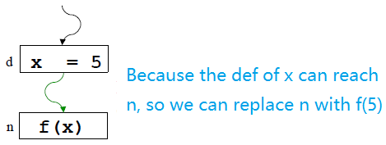
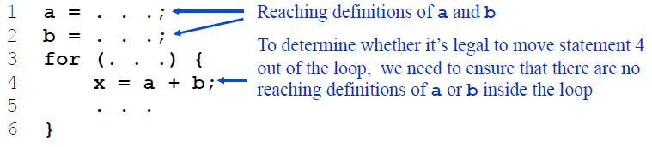
Uses of Reaching Definition
Build use-def/def-use chains
Constant propagation
Code Motion Out of Loops
17
Notes:
http://www.compileroptimizations.com/category/constant_propagation.htm
Constants assigned to a variable can be propagated through the flow graph and substituted at the use of the variable
https://en.wikipedia.org/wiki/Use-define_chain
Use-Def Chains → ud-chain of a variable’s use u is the list of pointers to all the definitions of the variable that reach u.
Def-Use Chains → du-chain of a variable’s definition d is the list of pointers to all the uses of the variable that are reachable by the definition d.
In computer programming, loop-invariant code consists of statements or expressions (in an imperative programming language) which can be moved outside the body of a loop without affecting the semantics of the program. Loop-invariant code motion (also called hoisting or scalar promotion) is a compiler optimization which performs this movement automatically.
https://en.wikipedia.org/wiki/Loop-invariant_code_motion

Slide 18
Equations of Reaching Definition
Source code
18

Slide 19
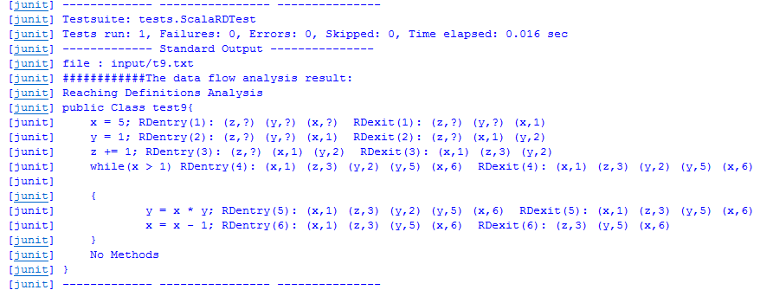
Junit Test Case of RD
19

Slide 20
Very Busy Expressions Analysis
For each program point, which expressions must be very busy at the exit from the point
Example (expression A+B ?)
1
very busy
not very busy
2
A =3
x= A+B
y = A+B
4/5
3
Z = A+B
20
Notes:
A expression A+B is very busy at point p if for all paths starting at p and ending at the end of the program, an evaluation of A+B appears before any definition of A or B
An expression is very busy at the exit from a label if , no matter what path is taken from the label, the expression must always be used before any of the variables occurring in it are redefined.

Slide 21
Uses of Very Busy Expressions
Code Hoisting
Code hoisting finds expressions that are always evaluated following some point in a program, regardless of the execution path and moves them to the latest point beyond which they would always be evaluated
It is a transformation that almost always reduces the space occupied but that may affect its execution time positively or not at all.
T=A+B
x = A+B
y = A+B
x= T
y= T
21
Notes:
http://www.compileroptimizations.com/category/hoisting.htm

Slide 22
Equations of Very Busy Expressions
Source code
22

Slide 23
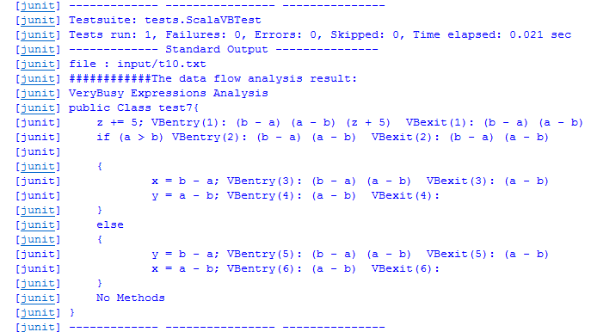
Junit Test Case of VB
23

Slide 24
Live Variables Analysis
For each program point, which variables may be live at the exit from the point.
Example
24
Notes:
A variable is live at the exit from a label if there exit a path from the label to a use of the variable that does not re-define the variable.

Slide 25
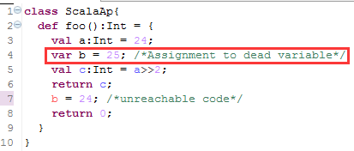
Uses of Live Variables
Register allocation
If a variable is not live, no need to keep it in a register
Dead-code elimination
If a variable is dead at assignment, we can eliminate this assignment
Code Motion Out of Loops
25
Notes:
A program contains an unbounded number of variables
Must execute on a machine with a bounded number of registers
Two variables can use the same register if they are never in use at the same time (i.e, never simultaneously live).

Slide 26
Equations of Live Variables
Source code
26

Slide 27
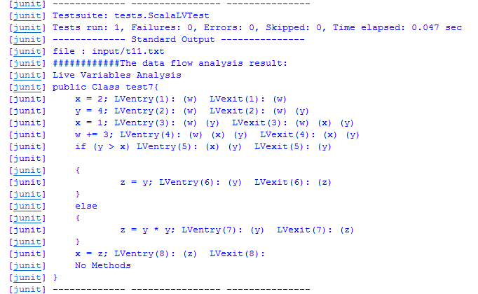
Junit Test Case of LV
27

Slide 28
Space of Data Flow Analyses
 | May /Must | Direction | Flow values | Initial guess
Available Expressions | Must Intersection | Forward | Set<Expression> | AexpStar
Reaching Definitions | May Union | Forward | Set<Map.Entry<Var,Label>> | Empty set
Very Busy Expressions | Must Intersection | Backward | Set<Expression> | AexpStar
Live Variables | May Union | Backward | Set<Var> | Empty set
28

Slide 29
Summary
Conclusions
An useful framework would make problems become easier.
Understand how compiler does work deeply
Understand some concepts about static program analysis
Future Works
Analysis about methods (intraprocedural and interprocedural)
Use ASM tool to change source code to get information from running time based on AST.
29

Slide 30
References
Principles of Program Analysis. Nielsen, Nielsen, and Hankin
http://jastadd.org/web/
http://jflex.de/
http://beaver.sourceforge.net/
Static Type Analysis of Pattern Matching by Abstract Interpretation. Pietro Ferrara at et.
Optimization and Performance Analysis of Scala over Java Compiler. Deepali Rai at el.
Constructing Call Graphs of Scala Programs, Karim Ali at el
30

Slide 31
Thank you !
Questions?
31

